Slide 1
What is Infrastructure as Code? An Introduction & Live Workshop
07/25/2022
Nashville Innovation and Delivery Center (NIDC)
Mitchell Ciupak

Slide 2
Agenda
Introduction
What is Infrastructure as Code?
IaC Tools
What is Terraform?
What is GitOps?
Workshop
GitHub and Contribution Rules
Using Terraform
Live Demo
Deployment

Slide 3
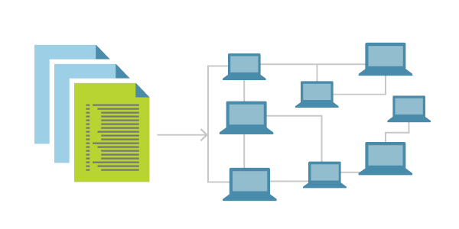
What is IaC (Infrastructure as Code)?
The Problem w/ Manual Configuration
Manually configuring your cloud infrastructure allows you to easily begin using new service offerings to quickly prototype architectures, however it comes with many downsides:
It is easy to mis-configure a service through human error.
It is difficult to manage or move the expected state of your configuration.
It is difficult to transfer knowledge of the configurations to other team members.
Infrastructure as Code (IaC)
You simply write a configuration in a script to automate the creation, updates, and destruction of your cloud infrastructure.
IaC is a blueprint for your infrastructure.
IaC can be easily shared, versioned, and acts as an inventory for your cloud infrastructure.
Notes:
- What is Infrastructure?

Slide 4




IaC (Infrastructure as Code) Tools
Popular Infrastructure as Code Tools
Declarative v. Imperative
There are two types of these tools. Declarative and Imperative. Declarative tools are explicit, largely non-conditional, and are typically written in JSON, YAML, or XML. Imperative tools tie into programming languages and offer the ability to be nested in conditionals or loops of the language, making them prone to misconfiguration.
Declarative Examples
Azure Blueprints
AWS CloudFormation
GCP Cloud Deployment Manager
Terraform
Imperative Examples
AWS CKD
More About Terraform
Terraform is a declarative IaC tool with its own language that supports loops, complex data structures, and dynamic blocks to a limited functional capacity. Offering the best of both worlds.
Notes:
What is the difference between declarative or imperative programming?

Slide 5
Infrastructure Management Tools
Provisioning v. Deployment v. Orchestration
Provisioning (Done by defining IaC)
To prepare a server with systems, data, and software, and then make it ready for network operation. When you launch and configure a server you are “provisioning it”.
Deployment (Done by Applying/ Deploying IaC)
The act of delivering a version of your application to run a provisioned server
Orchestration (Not IaC)
The act of coordinating multiple systems or services
Orchestration is a common term used when working with microservices, containers, and Kubernetes.
Orchestration is needed here because you are often managing thousands of containers.

Slide 6

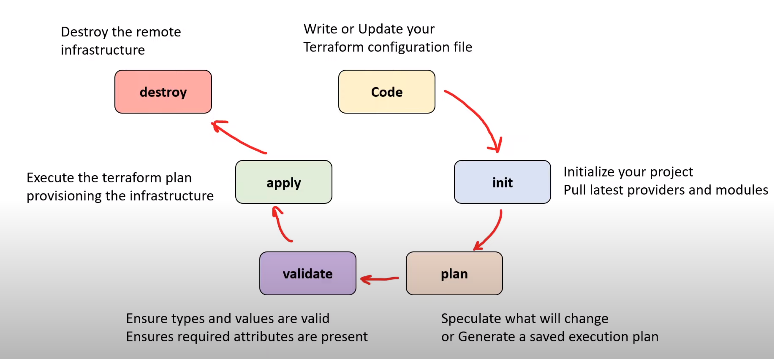
Terraform – A Deeper Dive
Terraform Re-Introduction
Terraform is a declarative IaC tool that is open-source and cloud-agnostic
Also…
Terraform Lifecycle
Change Automation - Immutability and State Management built-in. A way of creating a consistent, systemic, and predicable way of managing changes in infrastructure.
Execution Plans – Know the change your planning
Resource Graphs – Visualize an Execution Plan
Use Case – Multi-Tiered Single and Multi-Cloud Deployments offering Disposable Environments

Slide 7
Presentation Q&A

Slide 8
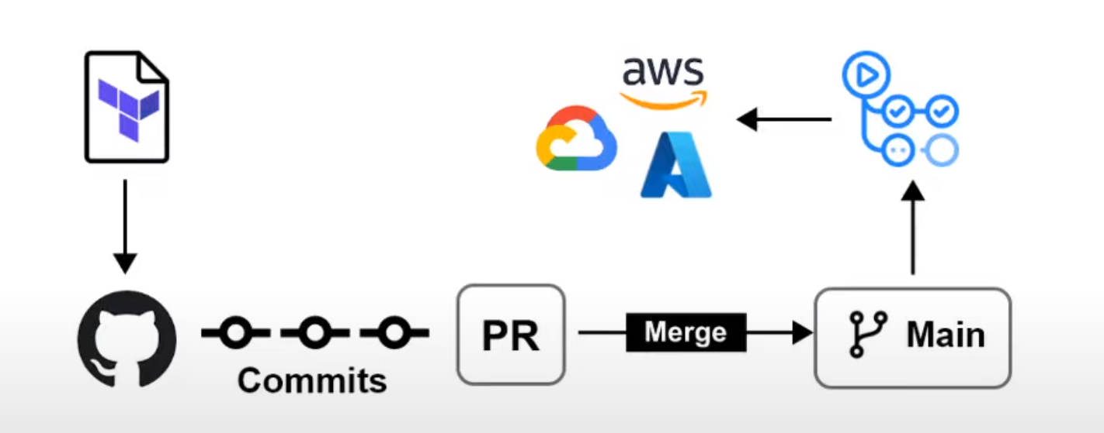
What is GitOps?
GitOps Automates Infrastructure Updates
GitOps is when you take Infrastructure as Code (IaC) and you use a git repository to introduce a formal process to review and accept changes to infrastructure. Once that code is accepted, it automatically triggers a deployment.
This is very powerful tooling and is the basis of CI/CD for cloud hosted resources.

Slide 9
Workshop
15 to 20 minutes

Slide 10
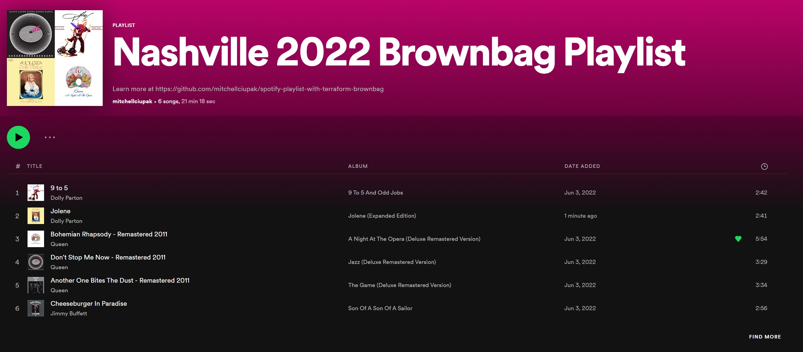
Let’s all get on the same page and workshop demo. What are we doing?
Creating a Spotify Playlist with Terraform
Notes:
Writing Some Terraform Code (HCL) to Specify Tracks in a Playlist
Authenticating with Spotify via a Docker Container
Deploying our playlist with IaC

Slide 11
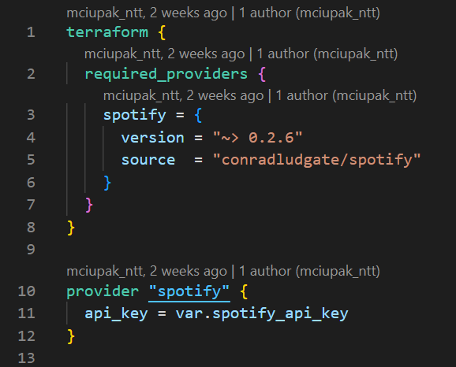
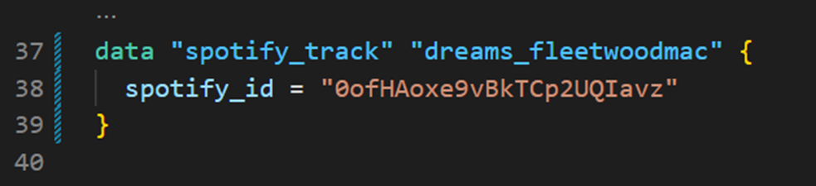
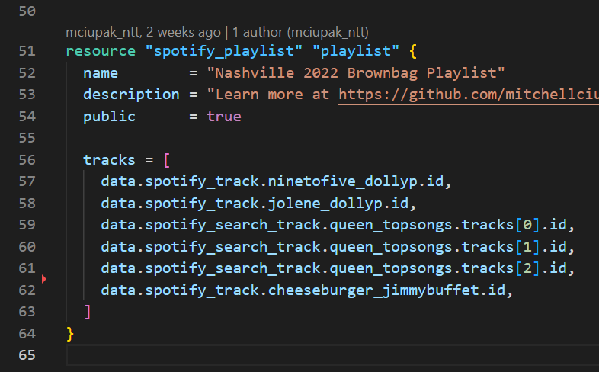
Let’s all get on the same page and workshop demo. What are we doing?
Writing Some Terraform Code (HCL) to Specify Tracks in a Playlist
Notes:
Providers
Terraform Plugins that allow you to interact with
Cloud Service Providers
E.g. Azure, AWS, or GCP
Software as a Service (SaaS) Providers
E.g. GitHub, Angola, Stripe
Other APIs
E.g. Kubernetes, Postgres
Providers are required in terraform configuration
Must be downloaded prior to deploy with terraform init
Blocks
Blocks are the syntactical containers for resources, data, and other types of objects represented in HCL
Blocks always have a type and a label. In the Data Block on the top right, ‘spotify_track’ is the type and ‘dreams_fleetwoodmac’ is the label or name of the block
Blocks also have arguments. In this case spotify_id is an argument

Slide 12
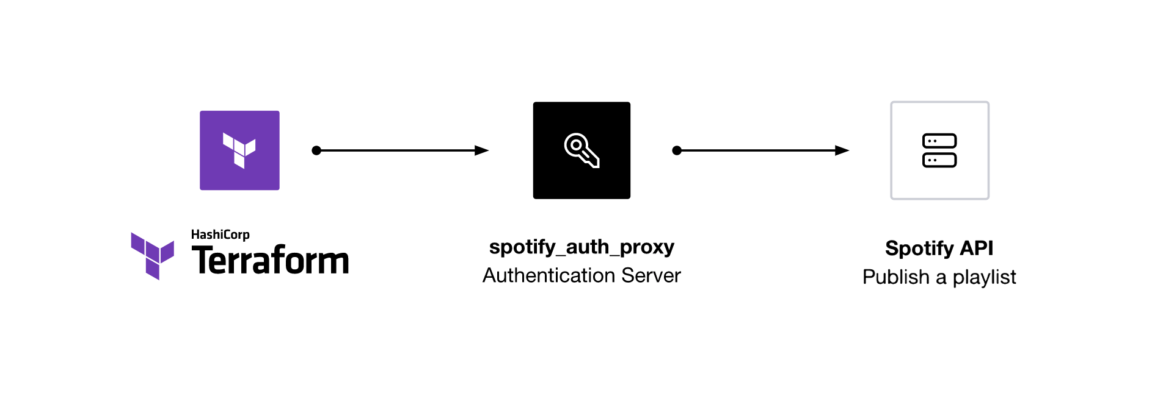
Let’s all get on the same page and workshop demo. What are we doing?
Authenticating with Spotify via a Docker Container
Notes:
Writing Some Terraform Code (HCL) to Specify Tracks in a Playlist
Authenticating with Spotify via a Docker Container
Deploying our playlist with IaC

Slide 13
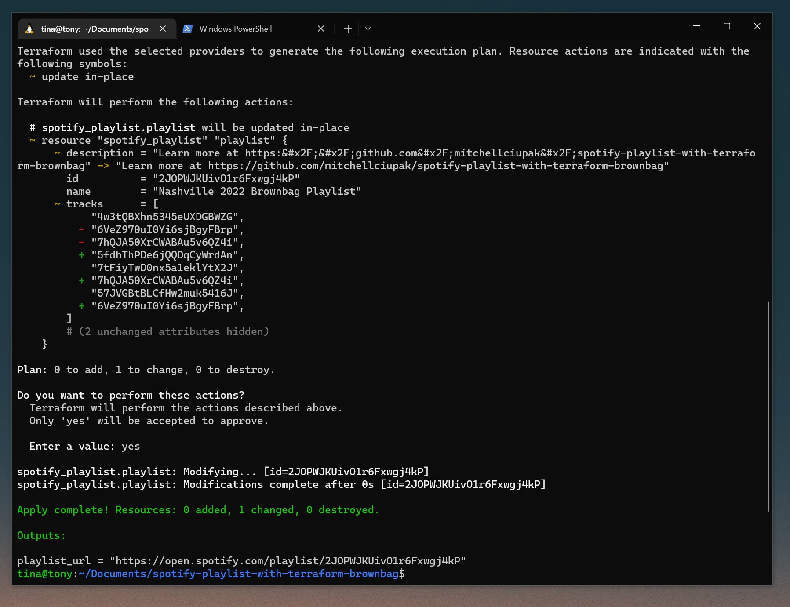
Let’s all get on the same page and workshop demo. What are we doing?
Deploying our playlist with IaC

Slide 14
Let’s talk about how to make a PR
Step 1: Create a GitHub Account
Step 2: Find The Project Repository
Step 3: Fork and Being to Add Your Song as Code to ./main.tf
Step 4: Create a Pull Request (PR) to Merge Your Code back into the Project
Step 5: Merge the Pull Request
Step 6: Deploy!
A Detailed List of Steps 1-4 is in the Appendix

Slide 15

Example of what to do
Live Demo
Notes:
Select a song from The EasyRetro Scrum Board: https://easyretro.io/publicboard/K4TJLfaixtZPhOqz3R0NH6xarN12/94132534-22e6-4fec-b883-5439a2bfd9e8
Add your name to the Song Card by clicking on the three dots in the corner of the card and clicking ‘Edit’
Move your song card to in progress and start coding (Full Instructions in Appendix
Create the fork
Edit the file in browser
Propose Change
Create a Pull Request
(Just Mitchell) Merge the PR
After all PRs are Merged, Deployment
Remote into PC
Authenticate to Spotify
docker run --rm -it -p 27228:27228 --env-file ./.env ghcr.io/conradludgate/spotify-auth-proxy
terraform init
terraform apply
yes
Share Playlist

Slide 16
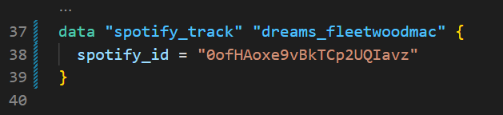
Let's do it
Start By Selecting a Song from The Board
Link to Scrum Board: https://easyretro.io/publicboard/K4TJLfaixtZPhOqz3R0NH6xarN12/94132534-22e6-4fec-b883-5439a2bfd9e8
Do Some Coding
Here is an example of a song in IaC
Add a data element like this to main.tf and add the element to the list of tracks!
Create A Pull Request
Link to Instructions: https://github.com/mitchellciupak/spotify-playlist-with-terraform-brownbag#contributing-rules
After Merging all the PRs, We Will Deploy!

Slide 17
Closing Q&A

Slide 18
Appendix

Slide 19
Contributing Rules – Steps 1 & 2
Step 1: Create or Sign Into Your GitHub Account
Please Refer to the ./presentation/IaC_brownbag_CreateAGitHubAccount.pdf document for instructions on how to signup for GitHub, otherwise sign into your account at https://github.com/.
Step 2: Navigate to The 'spotify-playlist-with-terraform-brownbag' Repository
Use the following link to get to the 'spotify-playlist-with-terraform-brownbag' Repository: https://github.com/mitchellciupak/spotify-playlist-with-terraform-brownbag

Slide 20
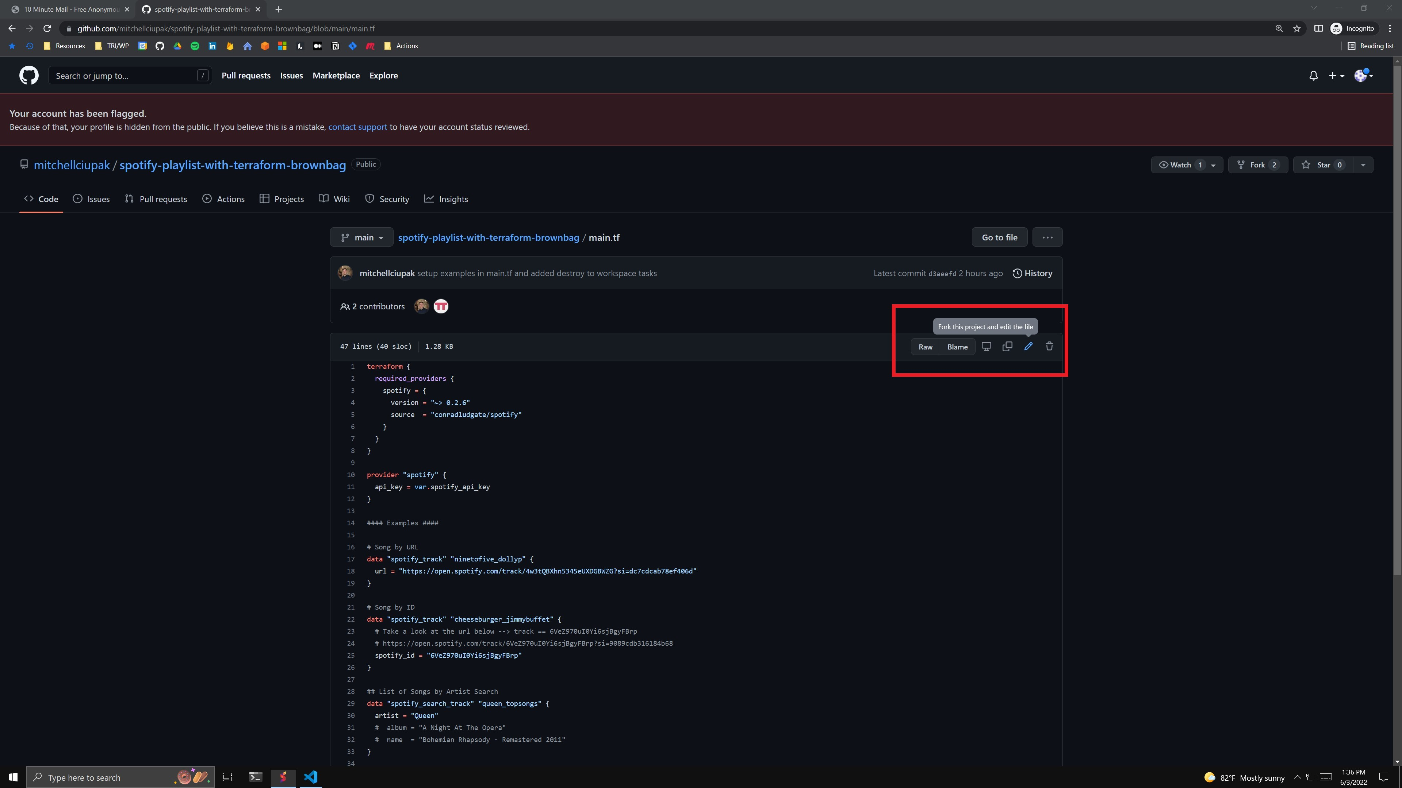
Contributing Rules – Step 3
Step 3a: Start Editing ./main.tf
Go to ./main.tf and select 'fork this project and edit this file' in the top right corner. This will automatically fork the original repository into your own account.

Slide 21
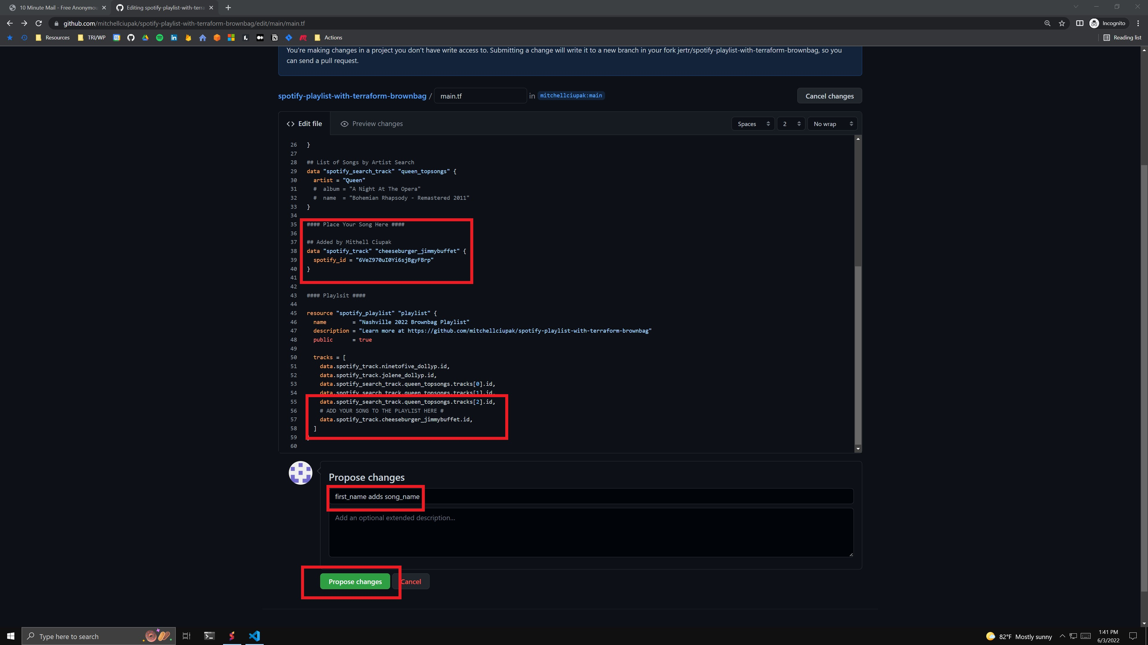
Contributing Rules – Step 3 (cont.)
Step 3b: Add your song to ./main.tf as code
Add your song as a data element. Add that data element to the playlist. Click 'Propose Change'.

Slide 22
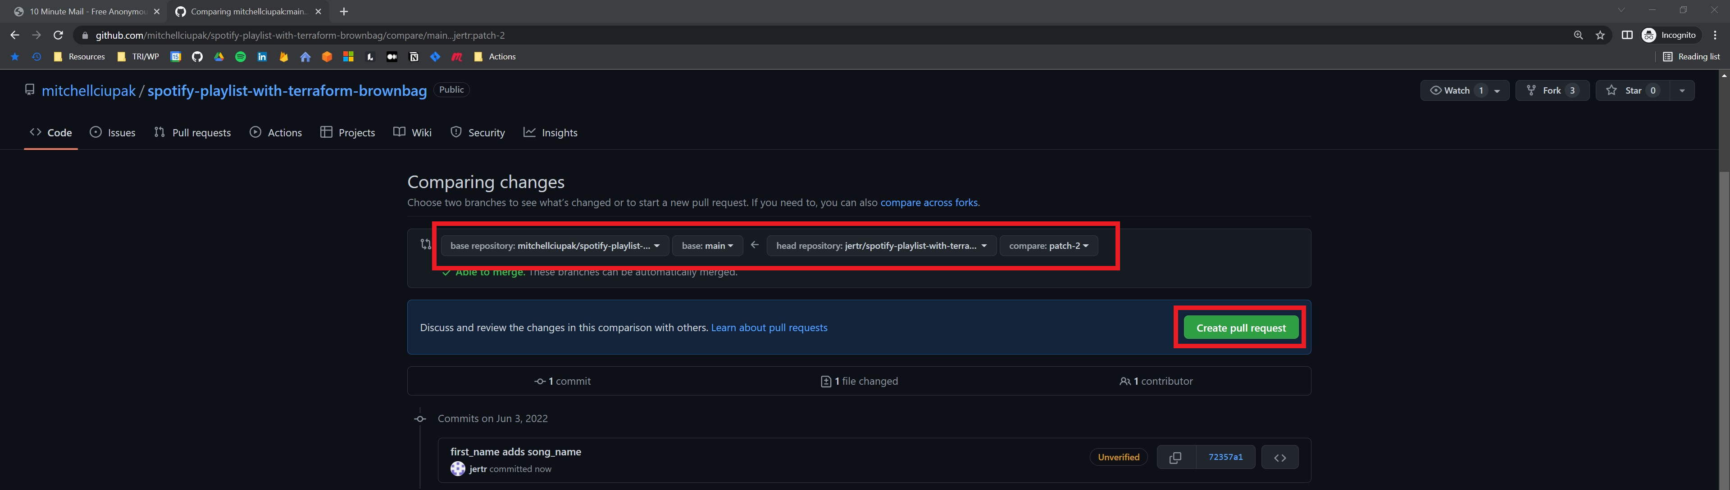
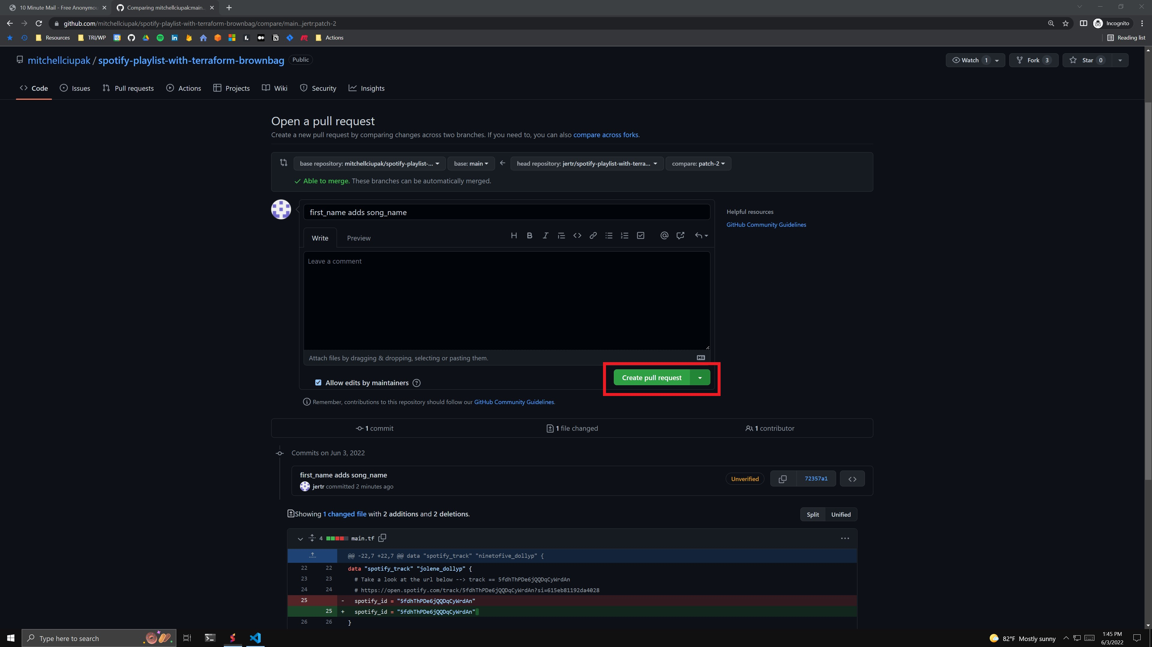
Contributing Rules – Step 4
Step 4a: Make a Pull Request
Validate that you are requesting to pull the correct branch into the correct branch and click 'Create Pull Request’. (top image)
Click ‘Create Pull Request’ (bottom image)

Slide 23
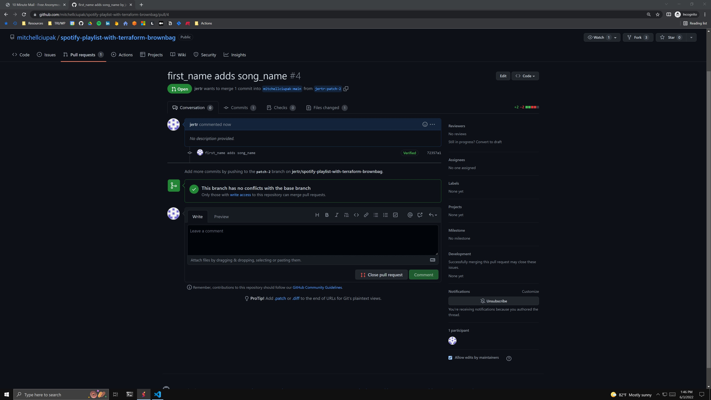
Contributing Rules – Step 4 (cont.)
Step 4b: Add your song to ./main.tf
Once you are on a page similar to this, you have successfully made a PR. Move your Card into the ‘In Review’ Column.
Notes:
Form – https://forms.office.com/r/wmmqzy196Q
Form Results - https://forms.office.com/Pages/DesignPageV2.aspx?origin=NeoPortalPage&subpage=design&id=b-DkZWPyH0y-y5DeuMLZ_4VqdpFK6xFEuA-eUuBAjn1UNEpZMFk3TVlGNzhIME5SQzlQWjBRNFVUVC4u&analysis=true
EasyRetro Board (Scrum Board) - https://easyretro.io/publicboard/K4TJLfaixtZPhOqz3R0NH6xarN12/94132534-22e6-4fec-b883-5439a2bfd9e8

Slide 24
